Slide 1
The Muggle Sorting Hat Group 5
Mentor : Jonas Schröder
Team :
Pamela Cerda Bertin
Lea Beiermann
Shofiyyah K. Nisa
Sam Saur

Slide 2
Agenda
Introduction of our project
Idea and Project Outline
Problems & Solutions
Accomplishments until now
Next Steps and Goals

Slide 3
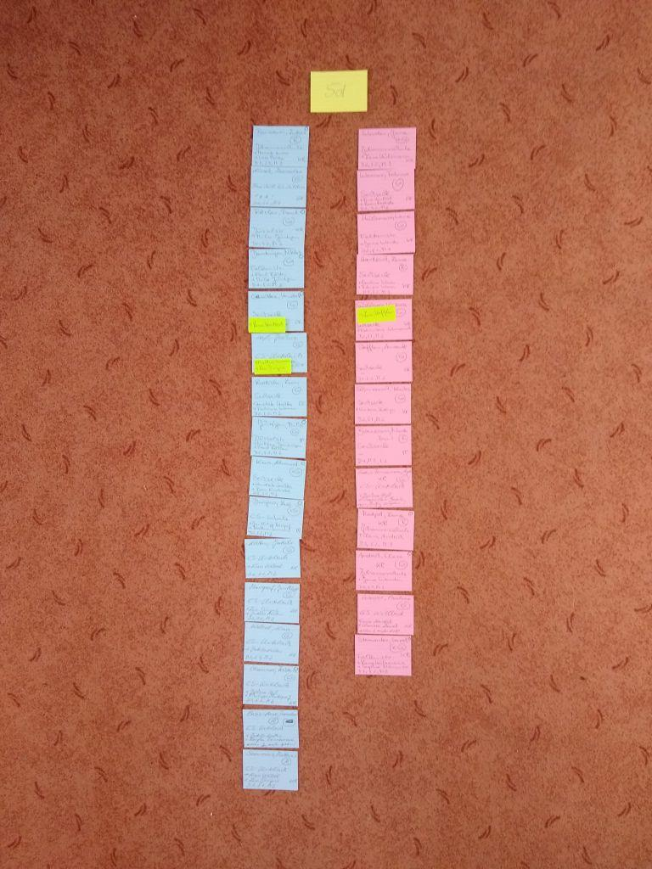
The Muggle Sorting Hat – Group 5
The Muggle Sorting Hat :
Teachers have difficulties forming classes of new students, or at least it is very time-consuming. Most teachers still form groups by hand, by writing names on papers and shuffling them around.
Our algorithm will sort students into groups based on various criteria, such as schools, age, friend preference, and psychological factors to help create a better learning environment. We will make it easier for the teachers to use our tool with the help of a user-friendly GUI, including e.g. a slider that shows different possible groups.
Picture 1. Example of how teachers form their classes

Slide 4
Idea & Project Outline
Initial Plan:
Weekly meetings followed up by creating dataset to scatter into specific groups
First Week Progress:
Brainstorming and Integrating with Github
Comparing different cluster methods
Creating dataset
Current Stage:
Deciding how we want to cluster our dataset

Slide 5
Problems & Solutions
?
Current Problem:
Combine clustering and the friend preference
Integrate the personality test into our algorithm
Clustering options -> groups vs individuals?
Solution: In Progress…
!
Specific Help Needed:
Integrating personality test into our algorithm

Slide 6
Accomplishments So Far
Crucial Accomplishment:
Theories well tested
Dataset finished
Algorithm improved
User-testing by a teacher
Conclusion:
We can see our code is working and is able to be implemented

Slide 7
Next Steps and Goals
Plans For Upcoming Weeks:
Implement clustering ideas
Figure out to implement certain aspects:
personality tests and the friend preference
To Finish:
Successfully implement our ideas into our algorithm and create a user-friendly interface

Slide 8
Thank you for listening to our presentation. Does anyone have any questions?

